Slide 1

PWM呼吸燈
國立成功大學 電機系
2022

Slide 2
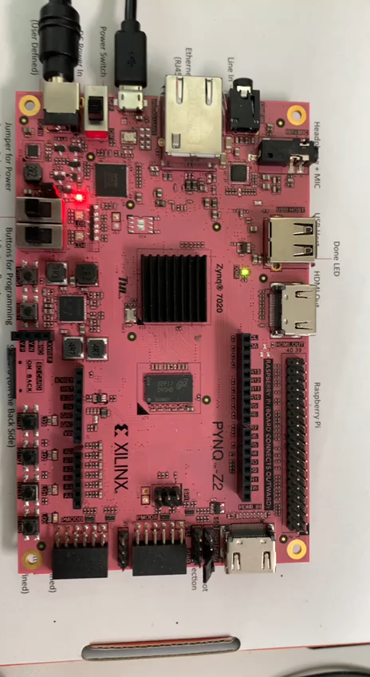
呼吸燈
1. 白光呼吸燈
2. 混色光呼吸燈

Slide 3
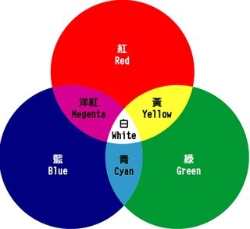
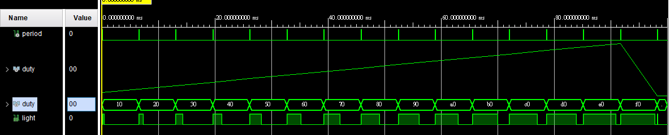



視覺暫留
1. 人眼的圖像滯留時間約為40ms(1/24幀畫面)。在此其間的變化無法被察覺。
2. 40ms內LED on和off所占的百分比在視覺上會出現亮與暗的區別。
3. 紅、綠、藍光可獨立刺激眼睛的受光體，人眼基於。
(ex, 紅色與綠色混合可以產生黃色或橙色，
三種原色以等比例疊加在一起時則會呈現白色。)

Slide 4
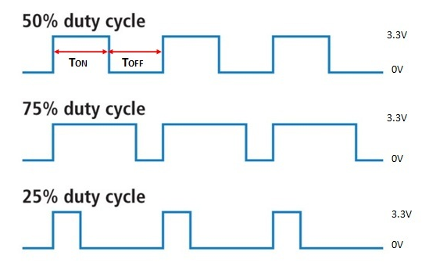

Duty cycle
Period T
D$uty= \frac{T_{ON}}{Period T}$

Slide 5
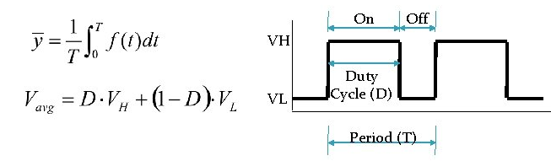
Pulse Wave Modulation
Pulse-wave Modulation (PWM) Uses a rectangular pulse wave whose pulse width is modulated resulting in the variation of the average value of the waveform.
Average value of a pulse waveform f(t) with period T and low value V_{L} high V_{H} can be found as
In general VL is zero; D is the duty; V_{avg} = D x V_{H}
The average value of the signal is directly dependent on the duty cycle D.
Output signal alternates between on and off within a specified period.

Slide 6
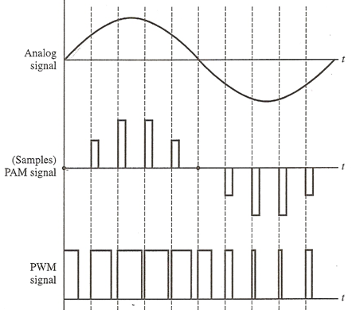
Lead Edge Modulation
Modulation Wave
Analog
Signal
phase0
phase1
phase2
phase3
phase4
Wave
phase
phase5
phase6
phase7
phase8
phase9
Discrete
Sample
PWM
Signal
Duty = 50%
Duty = 25%
Phase_trigger n
duty_triggers
duty_triggers
Phase_trigger n+2
Phase_trigger n+1

Slide 7
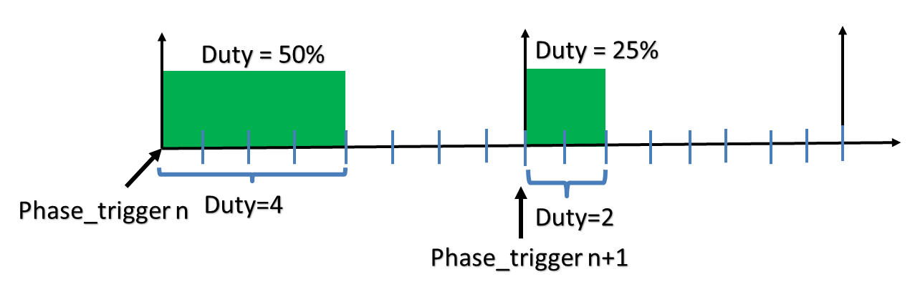
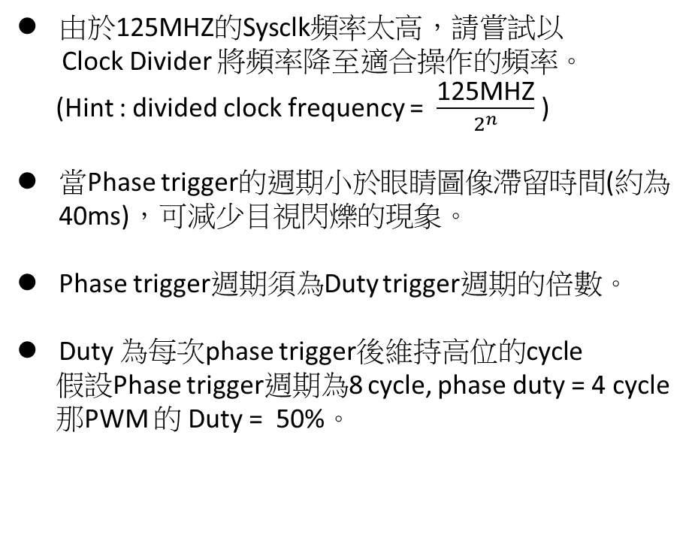
Simple Lead Edge Modulation
Sysclock
125HZ
由於125MHZ的Sysclk頻率太高，請嘗試以
Clock Divider 將頻率降至適合操作的頻率。
(Hint : divided clock frequency = $\frac{\text{125}\text{MHZ}}{2^{n}}$ )
當Phase trigger的週期小於眼睛圖像滯留時間(約為40ms)，可減少目視閃爍的現象。
Phase trigger週期須為Duty trigger週期的倍數。
Duty 為每次phase trigger後維持高位的cycle
假設Phase trigger週期為8 cycle, phase duty = 4 cycle
那PWM 的 Duty = 50%。
Switch
On/off
Clock divider
Ripple
Counter
result
divided
Clock
Phase Counter
Duty
trigger
Phase
trigger
Phase
Duty
PWM
light
Duty = 50%
Duty = 25%
Duty=4
Phase_trigger n
Duty=2
Phase_trigger n+1

Slide 8
Clock Divider
Sysclock
125HZ
Switch
On/off
module ripple_div(
input rst,
input sysclk,
output wire [31:0] div,
output wire div_clk
);
//31
dff_div d0( .rst(rst), .trigger(sysclk), .div(div[0]));
dff_div d1( .rst(rst), .trigger(div[0]), .div(div[1]));
…
…
…
dff_div d31( .rst(rst), .trigger(div[30]), .div(div[31]));
endmodule
Clock divider
Ripple
Counter
Result(div)
divided
Clock
(div_clk)
Phase Counter
Duty
trigger
Phase
trigger
Phase
Duty
PWM
light

Slide 9
Phase Counter
Sysclock
125HZ
module phase_counter(
input rst,
input enable,
input [7:0] phase_shift,
input[31:0] div,
input div_clk,
output wire duty_trig,
output wire phase_trig,
output wire [7:0] phase
);
reg [7:0] duty;
assign duty_trig = (div[7:0] == 8'hff) & enable;
assign phase_trig = (div[15:0] == 16'hff) & enable;
assign phase = div[27:20] + phase_shift;
endmodule
Switch
On/off
Clock divider
Ripple
Counter
Result(div)
divided
Clock
(div_clk)
Phase Counter
Duty
trigger
Phase
trigger
Phase
Duty
PWM
light

Slide 10
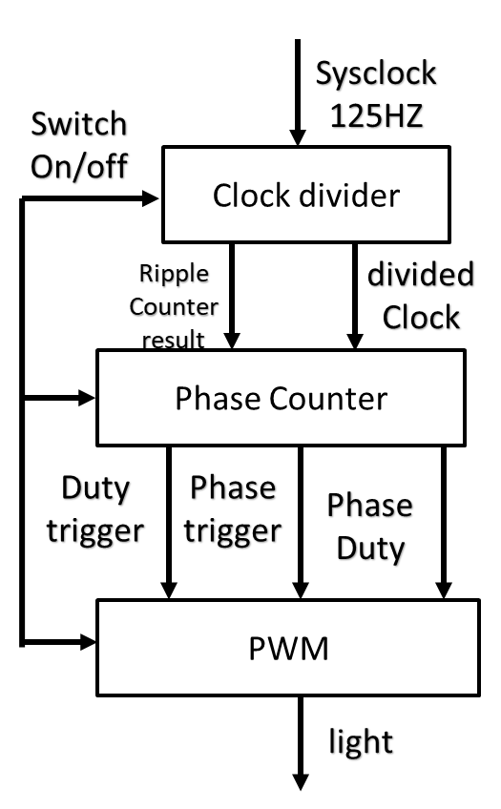
8 bit phase PWM
module pwm(
input rst,
input enable,
input duty_trig,
input phase_trig,
input [7:0] phase,
output wire out
);
reg[7:0] count;
assign out = ((count < phase) | phase_trig) & enable;
always@(posedge duty_trig or posedge rst)begin
if(rst)begin
count <= 8'b0;
end else if(phase_trig)begin
count <= 8'b0;
end else if(duty_trig)begin
count <= count + 1;
end else begin
count <= count;
end
end
endmodule
256 duty cycles between Phase_triggers

Slide 11
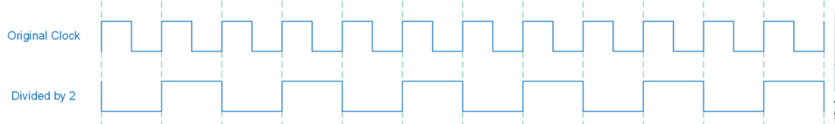
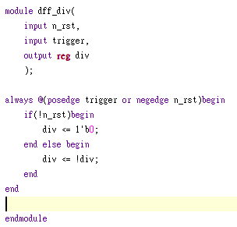
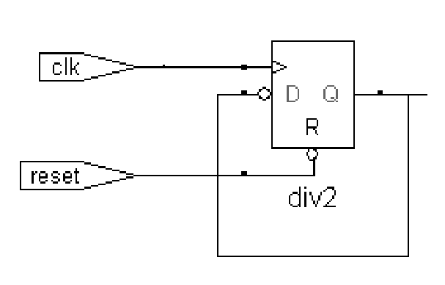
Clock Divider1
Divide clock frequency by 2
triggrt
div
n_rst

Slide 12
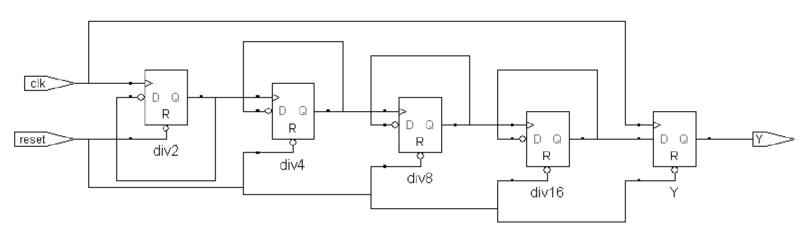
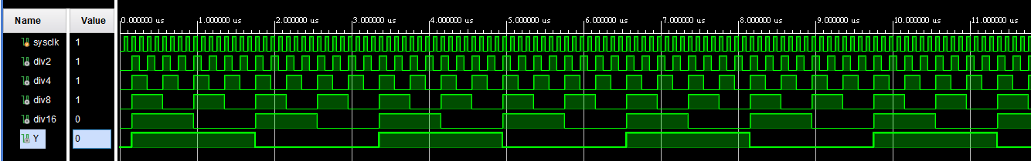
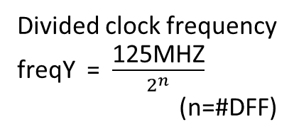

Clock Divider2
Clock divide by $2^{n} (n DFF個數)$
Divided clock frequency
freqY = $\frac{\text{125}\text{MHZ}}{2^{n}}$
(n=#DFF)

Slide 13
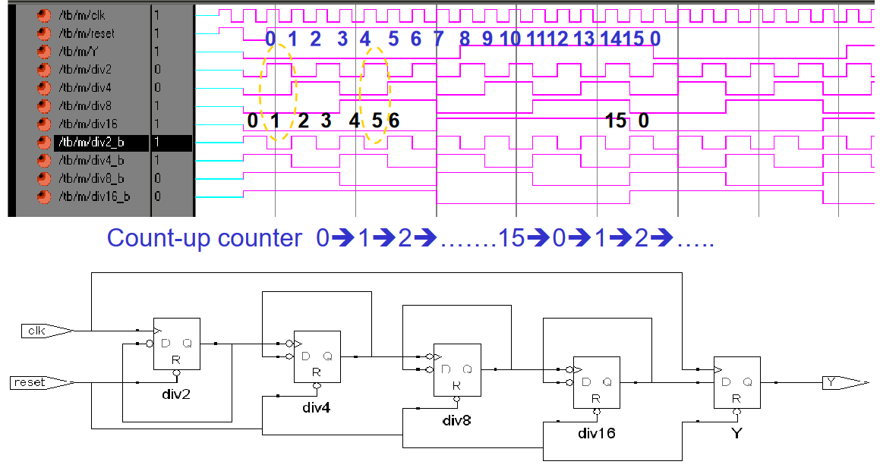
Ripple Counter

Slide 14
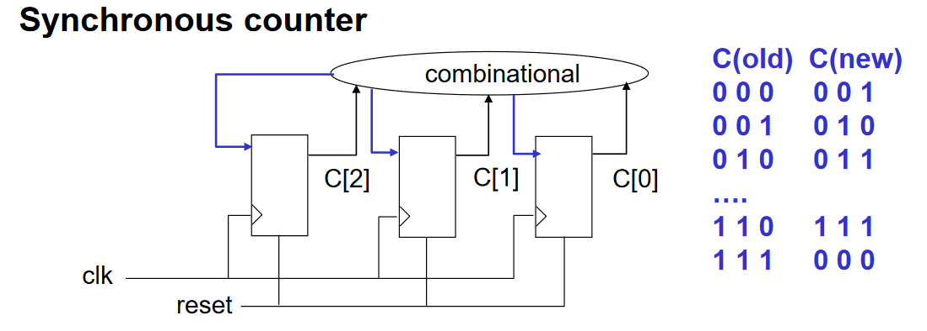
en
rst
always@(posedge clk or posedge rst)begin
if(rst)begin
C <= 3'b0;
end else if(en)begin
C <= C + 3'b1;
end else begin
C <= C;
end
end

Slide 15
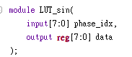
Digital Sinusoidal wave
/*NOTE
LUT_sin table is a wave look up table with 8 bit index from 0~255
the range of output data 0 ~ 255
*/

Slide 16
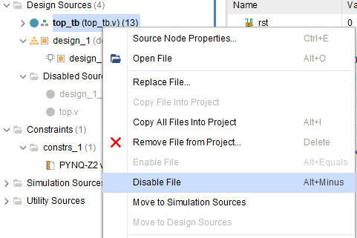
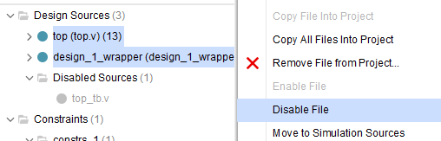
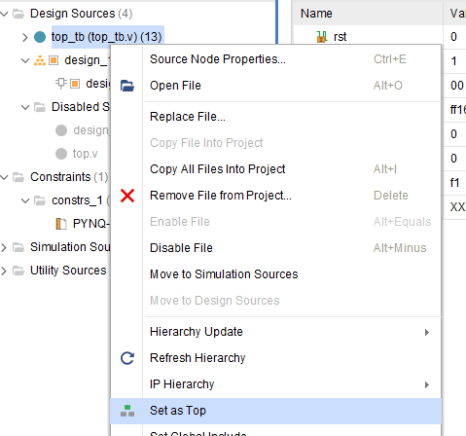
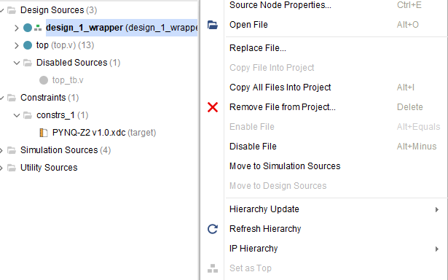
Simulation 1. Disable top.v 2. Disable design_1_wrapper.v 3. Enable top_tb.v 4. Set top_tb.v as top
FPFA synthesis
1. Enable top_tb.v
2. Enable top.v
3. Enable design_1_wrapper.v
4. Set design_1_wrapper.v as top

Slide 17
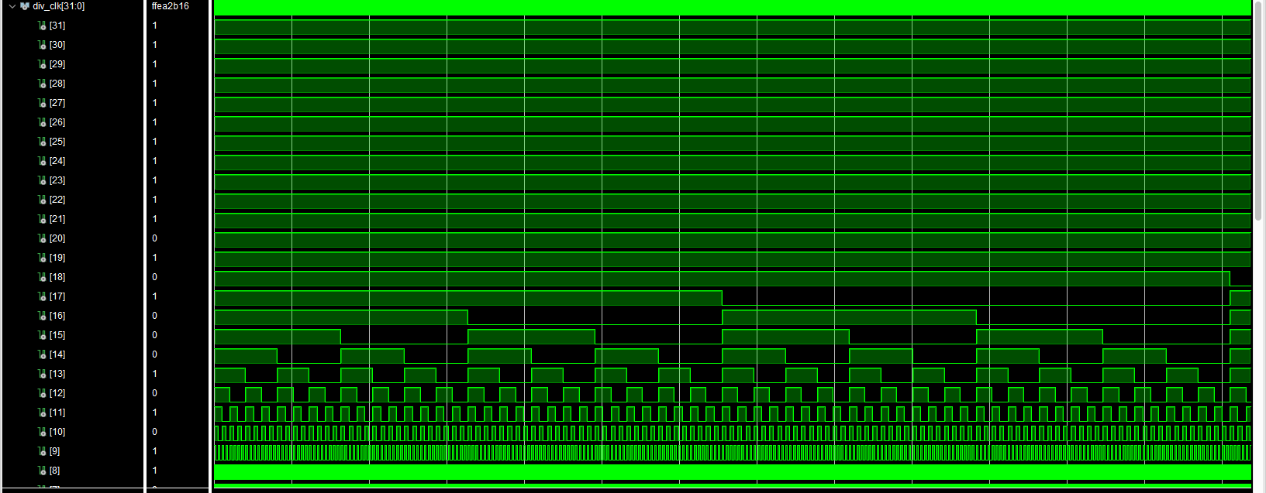
基礎題
產生一組clock divider之波型，結報需解釋波型的產生方法與波型圖擷圖(如下圖)。
以及開發版LED4及LED5之成果照片(白燈，及紅綠藍色燈)

Slide 18
加分題
請解釋 TOP.v 所呼叫的各函式之程式碼
越詳細分數越高
沒寫不扣分

Slide 19
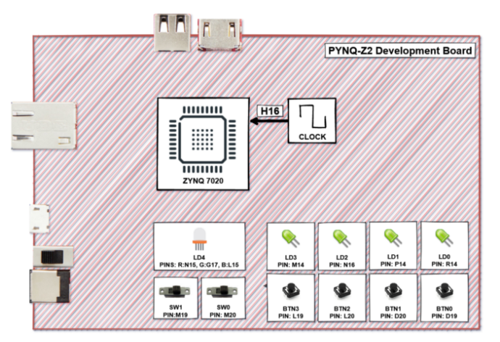
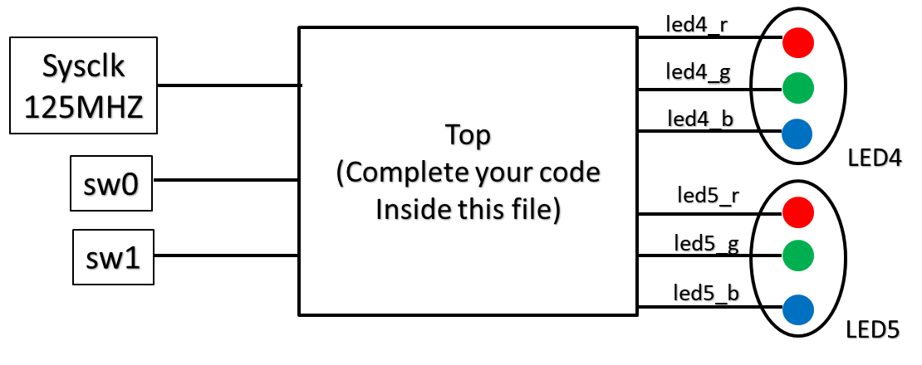
FPGA(60%)
同學需在lab9_Breathing_LED的專案內的
top.v檔實作呼吸燈電路。同學可依需求修改
top檔案內非port name的部分(切記不可修改
top.v 的port name，不然會合成失敗)。接著
合成Bitstream檔並燒入到FPGA內。
Note : FPGA內LED4、LED5內有三種獨立RGB LED燈。同學可自行挑選。沒有使用的output線路記得要在top module內接地。(Assign to 0)。
led4_r
Sysclk
125MHZ
Top
(Complete your code
Inside this file)
led4_g
led4_b
LED4
sw0
led5_r
sw1
led5_g
led5_b
LED5

Slide 20
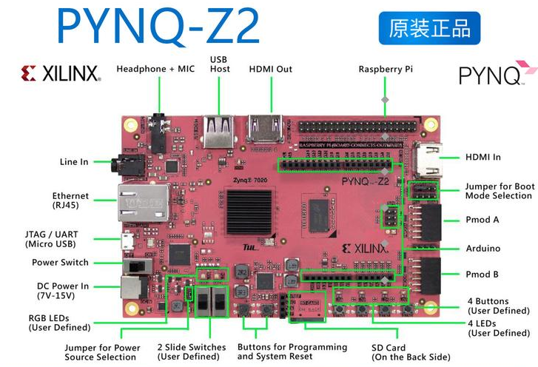
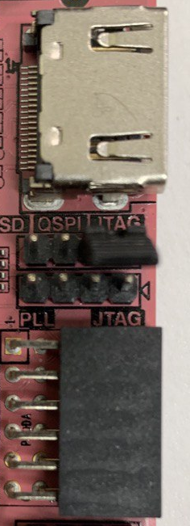
PYNQ-Z2 Board Hardware Introduction
Set Jumper to FPGA boot mode
FPGA Mode
v
v
v

Slide 21
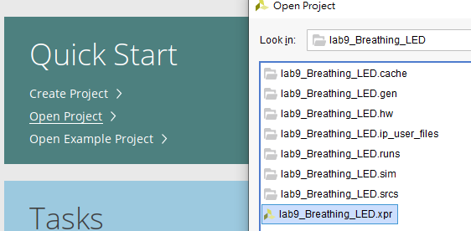
Install PYNQ-Z2 board file package
1. Go to ./lab9_base/package/
2. Copy the whole PYNQ-Z2 folder
to Vivado board files:
PATH%/Xilinx/Vivado/2021.2/data/boards/board_files
3. Open lab9 project template

Slide 22
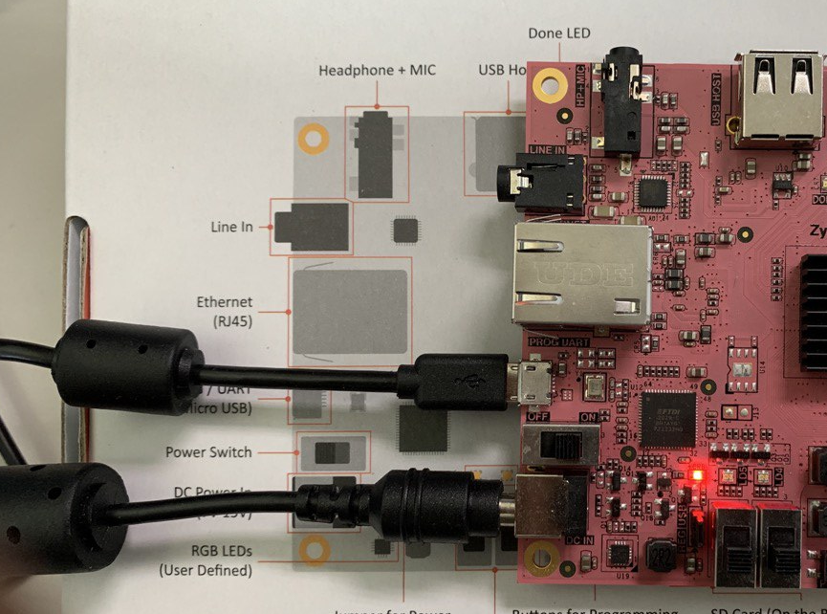
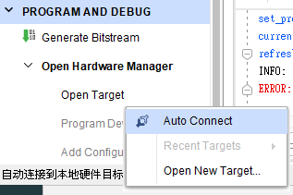
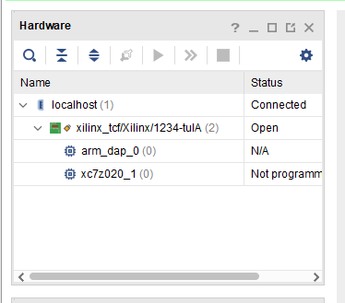
Board Connection Checking
1. plug micro USB and power port
2. Turn on power switch
3. Connect to device
4. Check hardware panel
power switch
.Connect to device(Left down manual )
Hardware panel

Slide 23
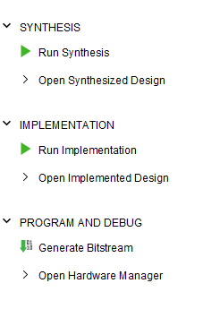
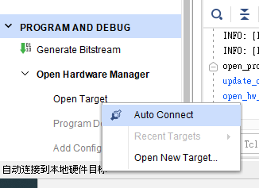
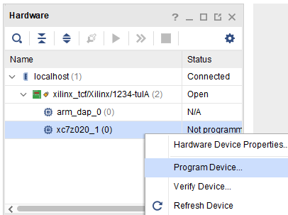
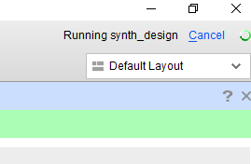
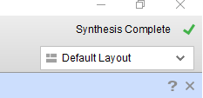
FPGA 合成&燒錄
1
4
5
2
6
3
Note up-right side
7
Busy
8
Done

